Slide 1
PowerCo
Customer Churn Analysis

Slide 2
Current Issue
11% of customers are not renewing their contracts with PowerCo
Business Impact
Decreased revenue growth
Decreased customer lifetime value
Loss in market share
Increased customer acquisition costs
Unstable revenue streams

Slide 3
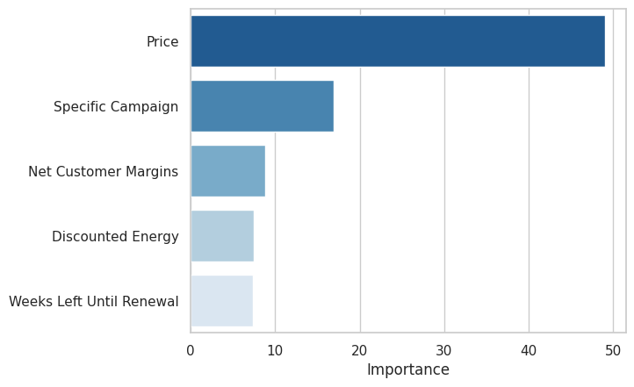
What drives churn?
Price sensitivity is the strongest churn predictor, followed by specific acquisition campaigns, and renewal timing.
This means customers are more likely to leave due to high prices, as well as fluctuations in those prices.
Ineffective campaigns also greatly contribute to churn.

Slide 4
Recommendations
Pricing
Offer more fixed-price contracts
Extend rate discounts to high-risk customers
Energy Campaigns
Focus spending on the campaigns with highest customer retention
Renewal Timing
Proactively offer contract renewals to customers

Slide 5
Next Steps
Customer Segmentation
Identify high-risk customers and continually monitor them for intervention
Further Analysis
Experiment with price strategy and renewal timing to understand customer preferences
Analyze the impacts of campaign strategy to identify customer pain points

